Slide 1



UNIT 2
Across cultures 2: Happy holidays
Part 1

Slide 2
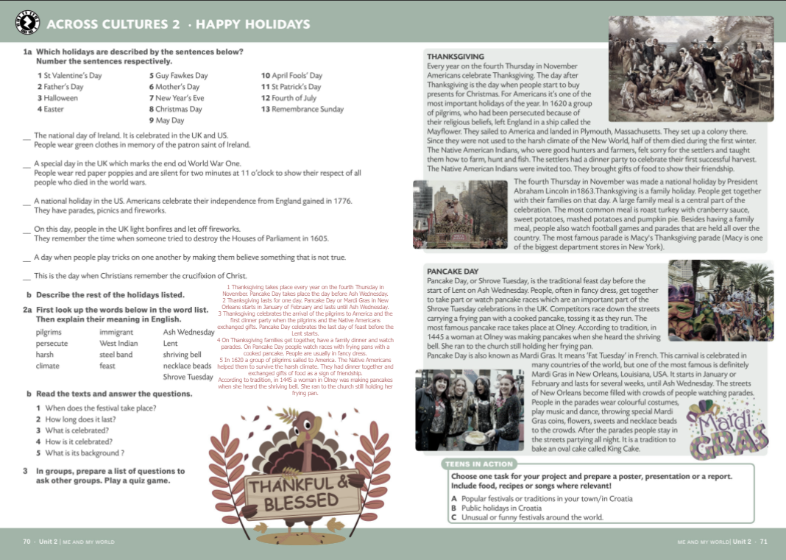
BRAINSTORMING
Fourth of July
St Patrick’s Day
HOLIDAYS
April Fools’ Day
Remembrance Sunday
May Day
St Valentine’s Day
Christmas Day
New Year’s Day
Father’s Day
Easter
Mother’s Day
Guy Fawkes Day
Halloween

Slide 3
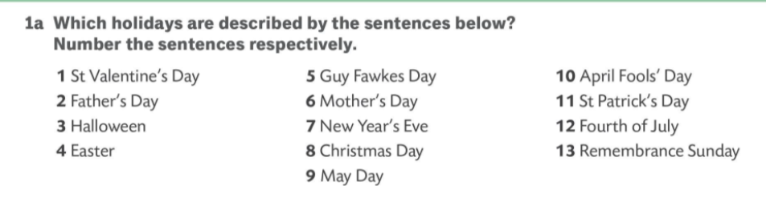
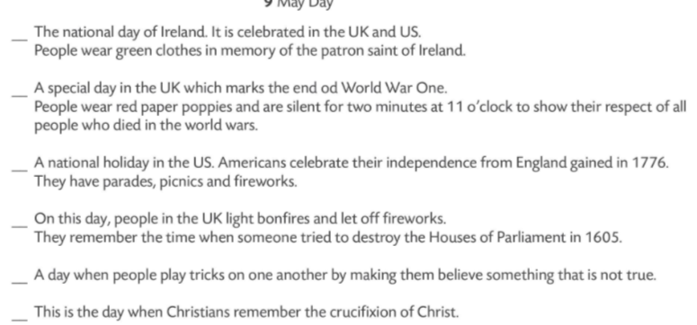
11
13
12
5
10
4

Slide 4
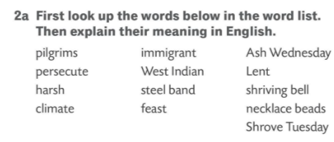
someone from the West Indies
a special meal with very good food or a large meal for many people
in the Christian religion, the 40 days before Easter
to treat someone unfairly or cruelly because of their race, religion, or beliefs
the day before the Christian period of Lent begins
cruel, unkind, or unpleasant in a way that seems unfair
someone who comes to live in a different country
a group of musicians who play large metal drums, sometimes made from oil containers
a small, coloured, often round piece of plastic, wood, glass, etc. with a hole through it, usually put on a string with a lot of others to make a necklace
the first day of Lent in the Christian religion
the weather conditions that an area usually has
bell that calls the faithful to confession before the solemn season of Lent
someone who travels to a place that is important in their religion

Slide 5
PILGRIMS - someone who travels to a place that is important in their religion
PERSECUTE - to treat someone unfairly or cruelly because of their race, religion, or beliefs
HARSH - cruel, unkind, or unpleasant in a way that seems unfair
CLIMATE - the weather conditions that an area usually has
IMMIGRANT - someone who comes to live in a different country
WEST INDIAN - someone from the West Indies
STEEL BAND - a group of musicians who play large metal drums, sometimes made from oil containers
FEAST - a special meal with very good food or a large meal for many people
ASH WEDNESDAY - the first day of Lent in the Christian religion
LENT - in the Christian religion, the 40 days before Easter
SHRIVING BELL - bell that calls the faithful to confession before the solemn season of Lent
NECKLACE BEADS - a small, coloured, often round piece of plastic, wood, glass, etc. with a hole through it, usually put on a string with a lot of others to make a necklace
SHROVE TUESDAY - the day before the Christian period of Lent begins

Slide 6
